Slide 1
RFT Template UPDATE CCDC 2 - 2020 Stipulated Price Contract Information session
Presented by: Anita Geier, Procurement Supervisor

Slide 2
OVERVIEW
CCDC 2 2020 Changes
MasterFormat
What is MasterFormat?
MasterFormat Framework
MasterFormat Benefits
CCDC Division 00 (Procurement & Contracting Requirements)
CCDC Division 01
(General Requirements)
Template Editing
Resources
Questions

Slide 3
OBJECTIVES
Provide information on TRCA’s updated RFT Stipulated Price Template
Division 00 (Procurement and Contracting Requirements)
Division 01
(General Requirements)
Notes:
This information session aims to …..(bullet points in slide)
Give staff a general idea, it does not offer a detailed explanation encompassing all aspects of the subject.
Staff should review the resources offered by Construction Specifications Canada (CSC) for a more in-depth explanation.
Give a general overview of the Format used to develop the template which was CCDC MasterFormat.

Slide 4
CCDC 2 2020 CONTRACT CHANGES (Brief Overview)
Ready‐for‐Takeover Milestone
Early Occupancy by the Owner
Payment Terms
Construction Safety
Insurance
Indemnification and Waiver
Some Clauses Relocated
Notes:
CCDC 2 – 2008 was updated because of changes to the Construction Act (payment legislation- prompt payment) in 2019
The new CCDC 2 2020 updates the standard form contract to include prompt payment
Fortunately, most of the familiar section numbers of the CCDC 2 contract were preserved.
Some of the changes include:
The introduction of the new “Ready-for-Takeover” project milestone.
The potential for early occupancy of the Work by the Owner.
The alignment of the payment process and terms with prompt payment legislation.
Under the new CCDC 2, the Contractor is responsible for health and safety AND the Owner is now also responsible for complying with health and safety requirements.
Limits for general liability insurance increased from $5M to $10M; and Limits for automobile and aircraft insurance increased from $5M to $10M;
And some clauses have been relocated provisions in Division 1 of the specifications

Slide 5
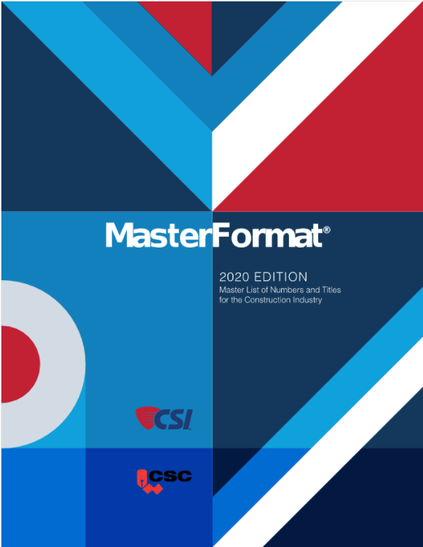
MASTERFORMAT
The updated template is based on MasterFormat
Framework & numbering system
Standard used to organize construction documents
“Written directions” for the project used throughout the industry for construction projects
Created by Construction Specification Institute (CSI) & Construction Specifications Canada (CSC)
Notes:
Contains all the information that was in the previous template it just formatted differently based on MasterFormat
The purpose of using MasterFormat is to assist users in organizing information into distinct groups when creating contract documents;
It’s an overall list of divisions and section numbers with associated titles to organize information about construction requirement/specification and associated processes;
ORGANIZATION AND PRESENTATION
.1 MasterFormat
The CCDC Master Specifications for Division 00 and Division 01 are organized into
Sections according to MasterFormat. MasterFormat is the North American standard that
provides a master list of numbers and titles for organizing construction information in a
standardized sequence. MasterFormat may be obtained at www.MasterFormat.com.
MasterFormat titles and numbers are organized into basic groupings of related
construction information called divisions and sections. Each division is identified by a
fixed number and title indicating the location of a primary element of the system, e.g.
Division 01 – General Requirements. Within each division there are numbered sections.
Each section covers one specific subject or a small group of associated subjects, e.g.
Section 01 11 00 - Summary of Work.
The inherent consistency and flexibility of this classification system allows for the
organization and assembly of the written part of the Contract Documents in a numerical
sequence that is universally recognized and understood in the North American design and
construction industry.

Slide 6
MASTERFORMAT BENEFITS
Provides structure and promotes a consistent method of organization
Documents are familiar to the industry
Helps organize documents and makes them more predictable
Enables users to quickly locate information
Notes:
MasterFormat makes it easier to organize huge amounts of data and information,
It is the industry standard;
Makes construction data more predictable therefore, making document drafting quicker and saves staff time;
it enables team members to refer to specific document sections and information can be easier to locate;

Slide 7
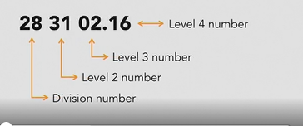
MASTERFORMAT FRAMEWORK
Overall List of Divisions
Broken Down Numerically
Division Numbers
Level Numbers
Notes:
Divided into 2 groups
It’s broken down numerically, starting off with the division number and subsequent level numbers
The Procurement and Contracting Requirements Group has only one division (Division 00−Procurement and Contracting Requirements),
The Specifications Group includes Division 01–General Requirements and the Technical specifications of Divisions 02 through 49.
Division 02-49 Describes the technical aspects of the quality of the materials and the quality of the work acceptable to the Owner/Consultant
Most often prepared by the Consultant
Facility Construction Subgroup
Division 02 — Existing Conditions
Division 03 — Concrete
Division 04 — Masonry
Division 05 — Metals
Division 06 — Wood, Plastics, and Composites
Division 07 — Thermal and Moisture Protection
Division 08 — Openings
Division 09 — Finishes
Division 10 — Specialties
Division 11 — Equipment
Division 12 — Furnishings
Division 13 — Special Construction
Division 14 — Conveying Equipment
Division 15 — RESERVED FOR FUTURE EXPANSION
Division 16 — RESERVED FOR FUTURE EXPANSION
Division 17 — RESERVED FOR FUTURE EXPANSION
Division 18 — RESERVED FOR FUTURE EXPANSION
Division 19 — RESERVED FOR FUTURE EXPANSION
Facility Services Subgroup:
Division 20 — Mechanical Support
Division 21 — Fire Suppression
Division 22 — Plumbing
Division 23 — Heating Ventilating and Air Conditioning
Division 24 — RESERVED FOR FUTURE EXPANSION
Division 25 — Integrated Automation
Division 26 — Electrical
Division 27 — Communications
Division 28 — Electronic Safety and Security
Division 29 — RESERVED FOR FUTURE EXPANSION
Site and Infrastructure Subgroup:
Division 30 — RESERVED FOR FUTURE EXPANSION
Division 31 — Earthwork
Division 32 — Exterior Improvements
Division 33 — Utilities
Division 34 — Transportation
Division 35 — Waterways and Marine Construction
Division 36 — RESERVED FOR FUTURE EXPANSION
Division 37 — RESERVED FOR FUTURE EXPANSION
Division 38 — RESERVED FOR FUTURE EXPANSION
Division 39 — RESERVED FOR FUTURE EXPANSION
Process Equipment Subgroup:
Division 40 — Process Interconnections
Division 41 — Material Processing and Handling Equipment
Division 42 — Process Heating, Cooling, and Drying Equipment
Division 43 — Process Gas and Liquid Handling, Purification and Storage Equipment
Division 44 — Pollution Control Equipment
Division 45 — Industry-Specific Manufacturing Equipment
Division 46 — Water and Wastewater Equipment
Division 47 — RESERVED FOR FUTURE EXPANSION
Division 48 — Electrical Power Generation
Division 49 — RESERVED FOR FUTURE EXPANSION

Slide 8
DIVISION 00 Procurement & Contracting Requirements
Notes:
The first group is Division 00 - Procurement & Contracting Requirements;
General conditions (General Provisions – Administration of the Contract)
Supplementary Conditions – Amendments to the general conditions modifications;

Slide 9
DIVISION 00
Procurement & Contracting Requirements (cont’d)
Notes:
Table of Contents

Slide 10
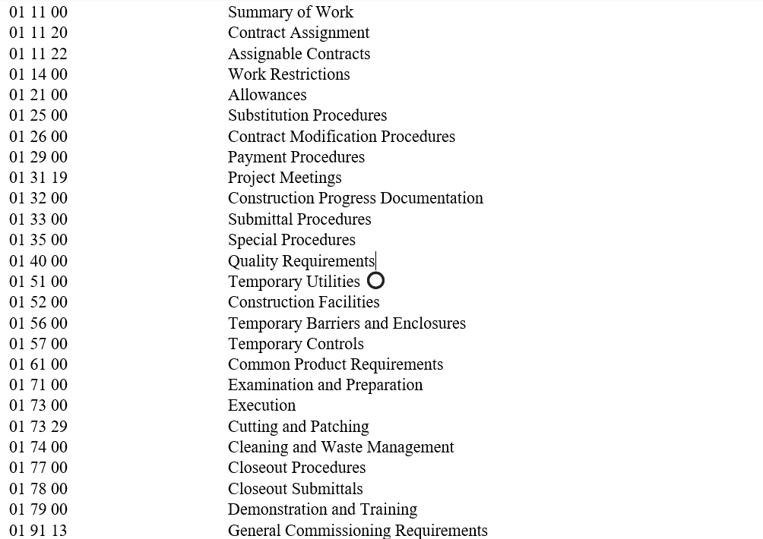
DIVISION 01 General Requirements
Sets out the administrative and procedural specifications/rules for the entire project.
Information that is common to all work results, eliminates repetition in division 02-49
Say it once, only once, and in the right place

Slide 11
TEMPLATE EDITING
1.7 SITE EXAMINATION
CHOOSE: [Bidders must satisfy themselves by personal examination of the Place of the Work and familiarize themselves with conditions and requirements for the Work before submitting a bid.] OR [Bidders’ opportunity to visit the Place of the Work will be in conjunction with the specified Pre-Bid Site Meeting – Section 1.8].
[Refer to 00 31 00 - Available Project Information which identifies available information pertaining to the Project]. Note to staff: Delete if there is no available project information.
By inference of the “Concealed or Unknown Conditions” GC in the General Conditions of the Contract, Bidders shall include in their bid price for non-concealed and known conditions that are either visible or can be reasonably inferred from a site examination at the Place of the Work before the bid submission.
No claim, arising from the Bidder’s failure to adequately examine the Place of the Work will be considered.
1.8 [PRE-BID SITE MEETING] Note to staff: Delete this entire section if not required
A pre-bid site meeting at the Place of the Work [insert location details/address] has been scheduled for [_____ a.m./p.m.] local time on [ ], 20[ ].
Edit for project specific use
Square brackets [ ], highlighted text and red text indicate notes to staff and user project specific choices
Deleting sections
Maintain the “End of Section”
Notes:
Division 00 & 01 are intended to be edited for project specific use.
You should select sections that will be applicable to a given project and edit them, if required, to suit the project, nature of the work, and site.
You can delete division 01 sections that are not required for your project.
Square brackets, highlighted text and red text appear throughout the document to indicate notes to staff and user project specific choices to assist with the editing process and must be removed so not to appear in the final RFT that will be sent/posted;
Please let me know if you have any feedback and also any feedback you might receive from vendors.

Slide 12
PROCUREMENT HUB SPACE RESOURCES
Notes:
The resources listed are available to staff and are located on the procurement hub space and will give you a more in-depth understanding of CCDC 2 2020, MasterFormat and Division 00 and 01.
The guide to CCDC 2 is dated 2008 but is the most recent one.

Slide 13
OTHER RESOURCES
CCDC guides related to this information session are available on the Procurement Hub Space Procurement Information Materials (trcastaff.ca)
Construction Specifications Canada (CSC)
www.csc-dcc.ca
Construction Specifications Institute (CSI) www.csiresources.org
Link to Gowlings article provides a brief summary of changes to CCDC 2 2008 https://gowlingwlg.com/en/insights-resources/articles/2020/what-the-new-ccdc-2-stipulated-price-contract-mean/

Slide 15
QUESTIONS

